Slide 1
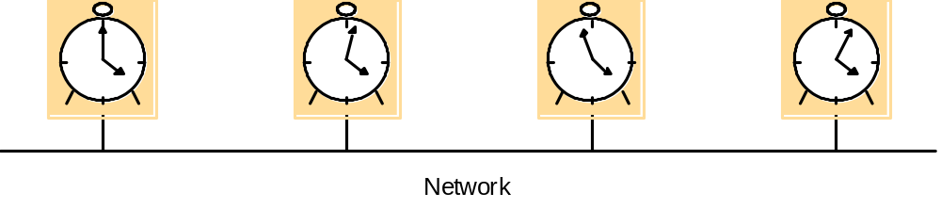
Skew between computer clocks in a distributed system

Slide 2
Clock synchronization using a time server
m
r
m
t
p
Time server,S

Slide 3
An example synchronization subnet in an NTP implementation
1
2
2
3
3
3
Note: Arrows denote synchronization control, numbers denote strata.

Slide 4
Messages exchanged between a pair of NTP peers
Server B
T
i
-2
T
i-1
Time
m
m'
Time
Server A
T
i
-
3
T
i

Slide 5
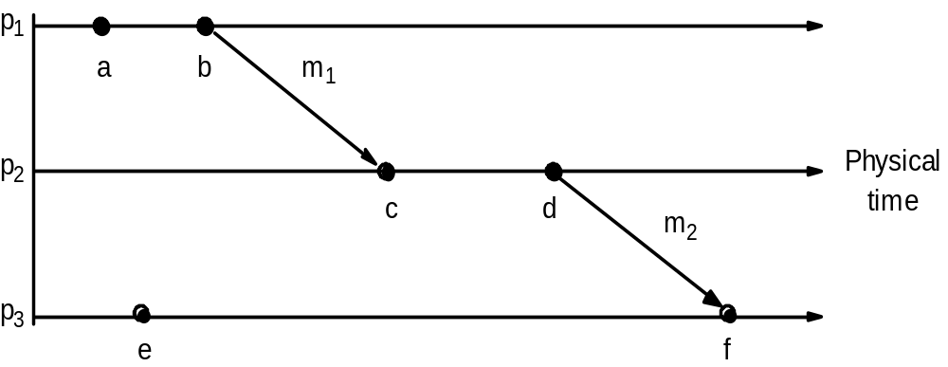
Events occurring at three processes

Slide 6
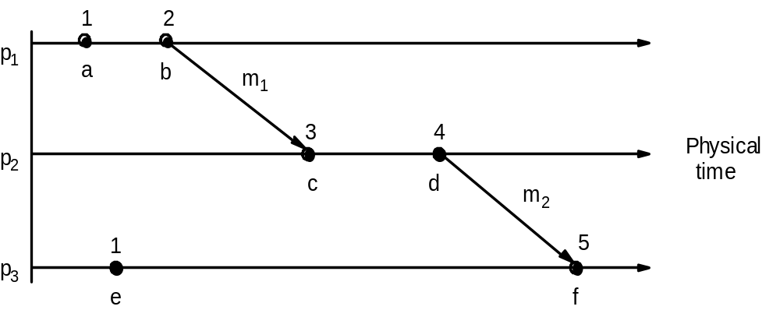
Lamport timestamps for the

Slide 7
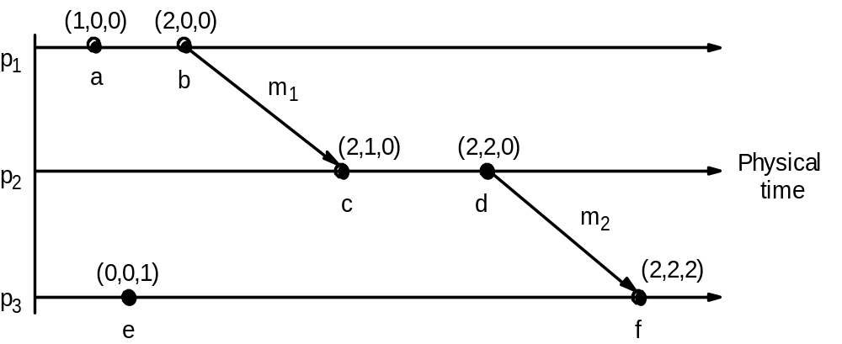
Vector timestamps for the events

Slide 8
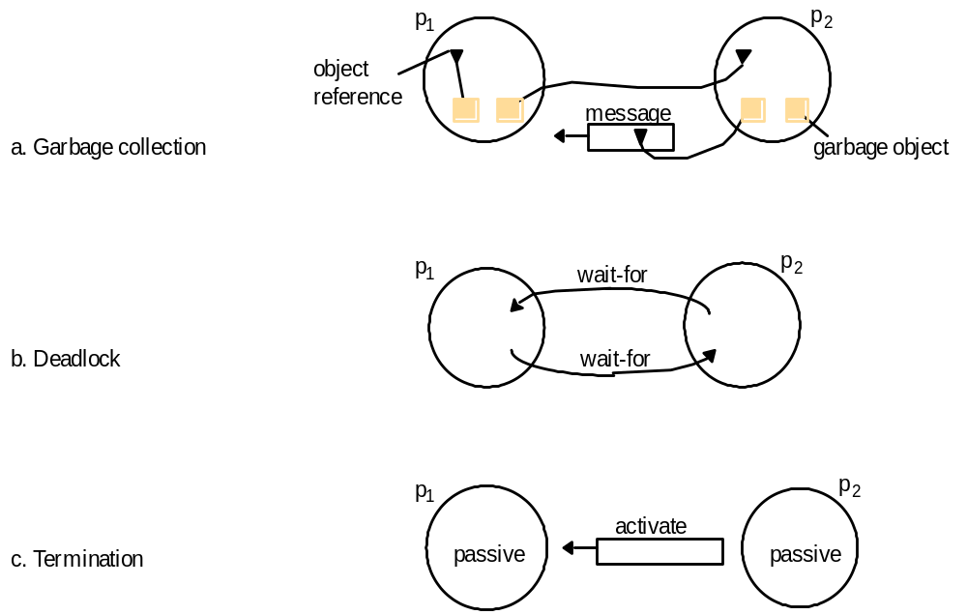
Detecting global properties

Slide 9
Cuts
e
0
e
1
e
2
e
3
1
1
1
1
p
1
m
1
m
2
p
Physical
2
time
e
0
e
1
e
2
2
2
2
Inconsistent cut
Consistent cut

Slide 10
Chandy and Lamport’s ‘snapshot’ algorithm
Marker receiving rule for process p_{i}
  On p_{i}’s receipt of a marker message over channel c:
  if (p_{i} has not yet recorded its state) it
    records its process state now;
    records the state of c as the empty set;
    turns on recording of messages arriving over other incoming channels;
  else
    p_{i} records the state of c as the set of messages it has received over c
    since it saved its state.
  end if
Marker sending rule for process p_{i}
  After p_{i} has recorded its state, for each outgoing channel c:
  p_{i} sends one marker message over c
  (before it sends any other message over c).

Slide 11
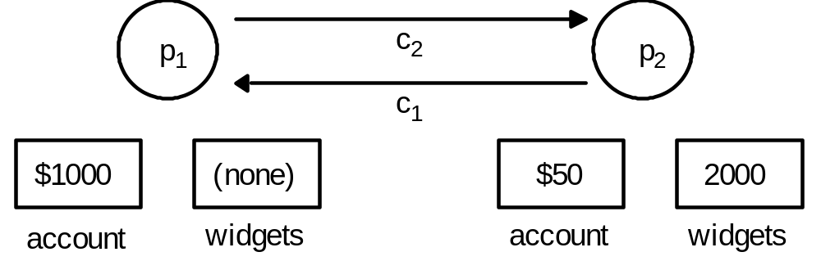
Two processes and their initial states

Slide 12
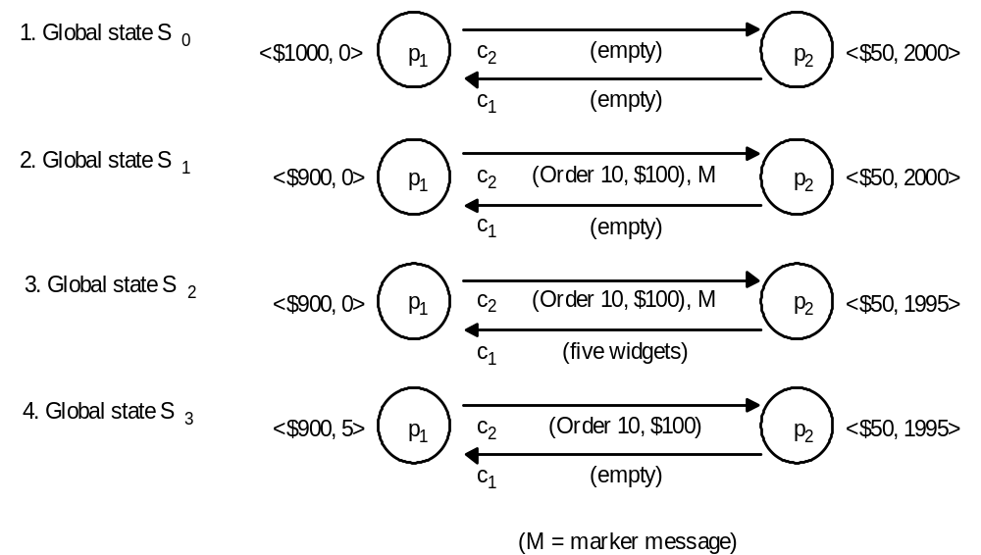
The execution of the processes

Slide 13
Reachability between states in the snapshot algorithm
actual execution e
0
,e
1
,...
S
recording
recording
S
init
begins
final
ends
S
snap
'
'
'
'
'
pre-snap: e
0
,e
1
,...e
R-1
post-snap: e
R
,e
R+1
,...

Slide 14
Vector timestamps and variable values for the execution of Figure
(1,0)
(2,0)
(3,0)
(4,3)
x
1
= 1
x
1
= 100
x
1
= 105
x
1
= 90
p
1
m
1
m
2
p
Physical
2
time
x
2
= 100
x
2
= 95
x
2
= 90
(2,1)
(2,2)
(2,3)
Cut C
2
Cut C
1

Slide 15
The lattice of global states for the execution of Previous Figure
Level 0
S
00
1
S
10
2
S
20
Sij = global state after i events at process 1
and j events at process 2
3
S
30
S
21
4
S
31
S
22
5
S
32
S
23
6
S
33
7
S
43

Slide 16
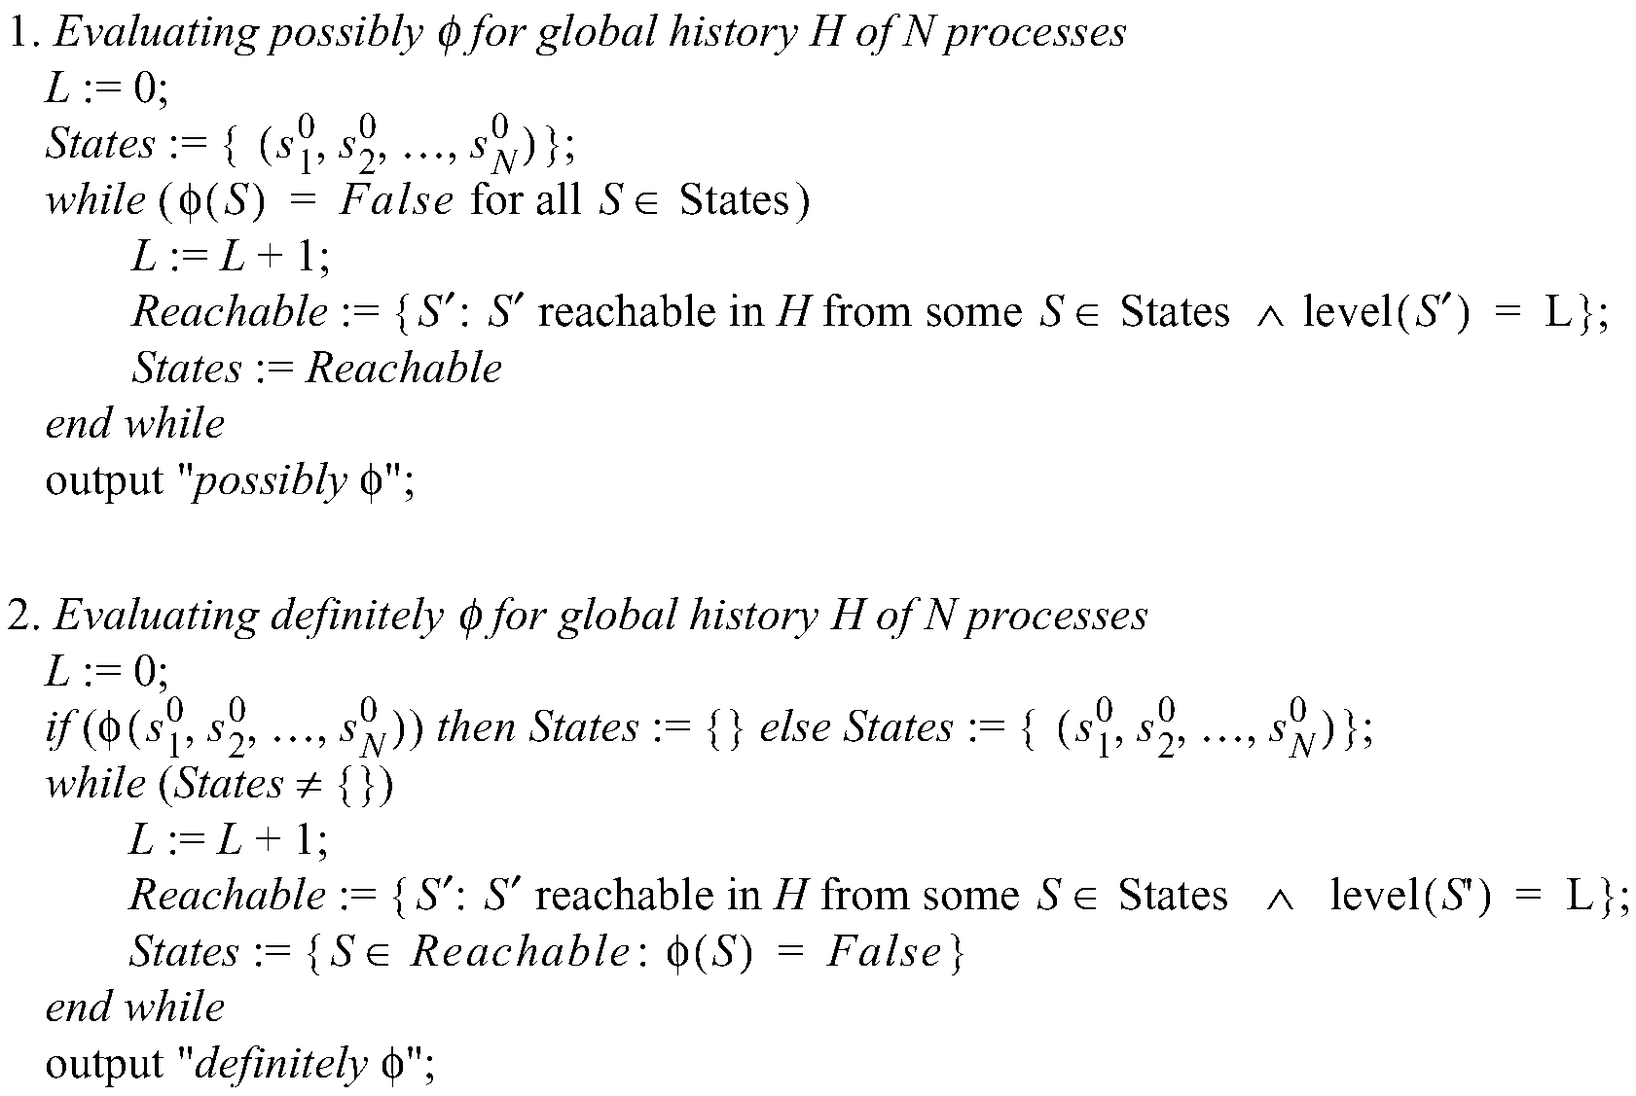
Algorithms to evaluate possibly φ and definitely φ

Slide 17
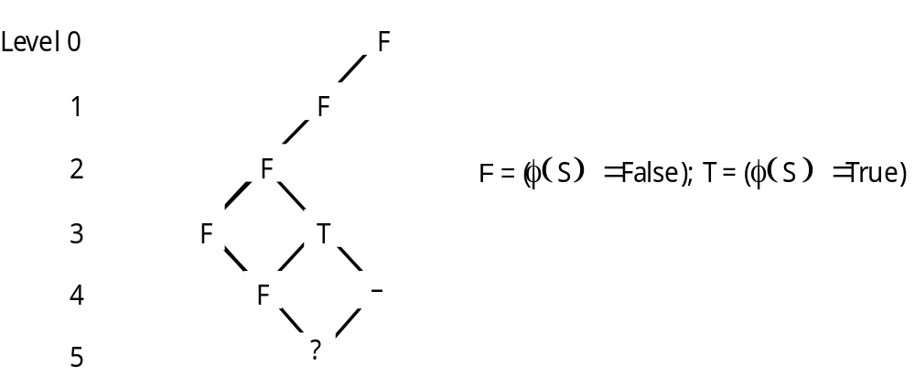
Evaluating definitely φ

